Slide 1
Determining the Grip Strength of a Robotic Manipulator
Anna Martin, Mechanical Engineering
Mentor: Dr. Spring Berman
School for the Engineering of Matter, Transport and Energy

Slide 2
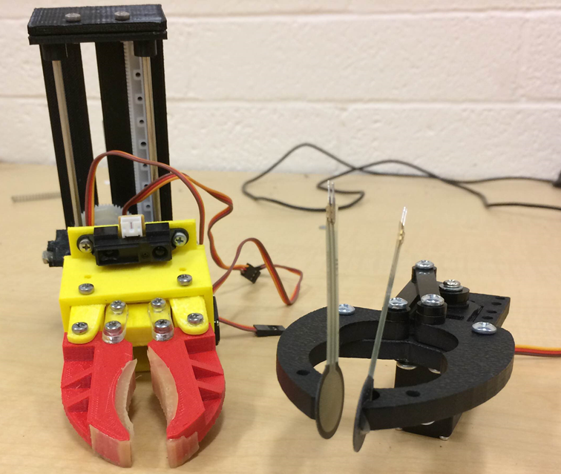
Overview
Autonomous robots will have to sense the amount of force their robotic arm applies to an object, determine if that force is too high or too low, and adjust its force output accordingly.
Force Sensing Resistors (FSRs) were used to determine this force output.
  Tested for stability and precision on their own and for accuracy against a torsion spring setup.
Applications in robotics: construction and assembly, repairing damaged equipment, load manipulation

Slide 3
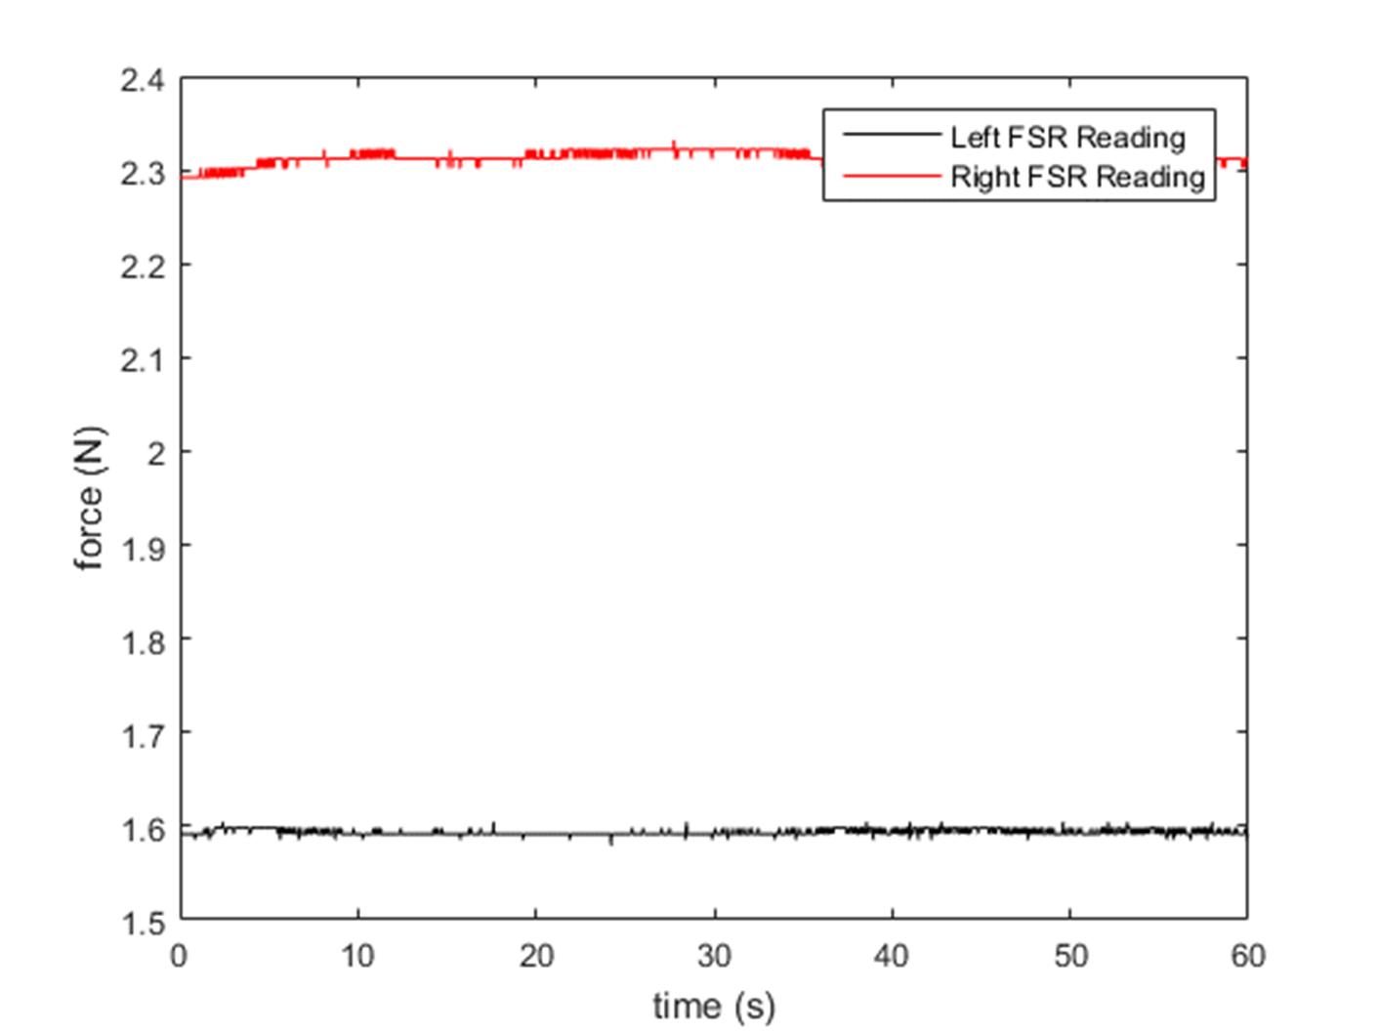
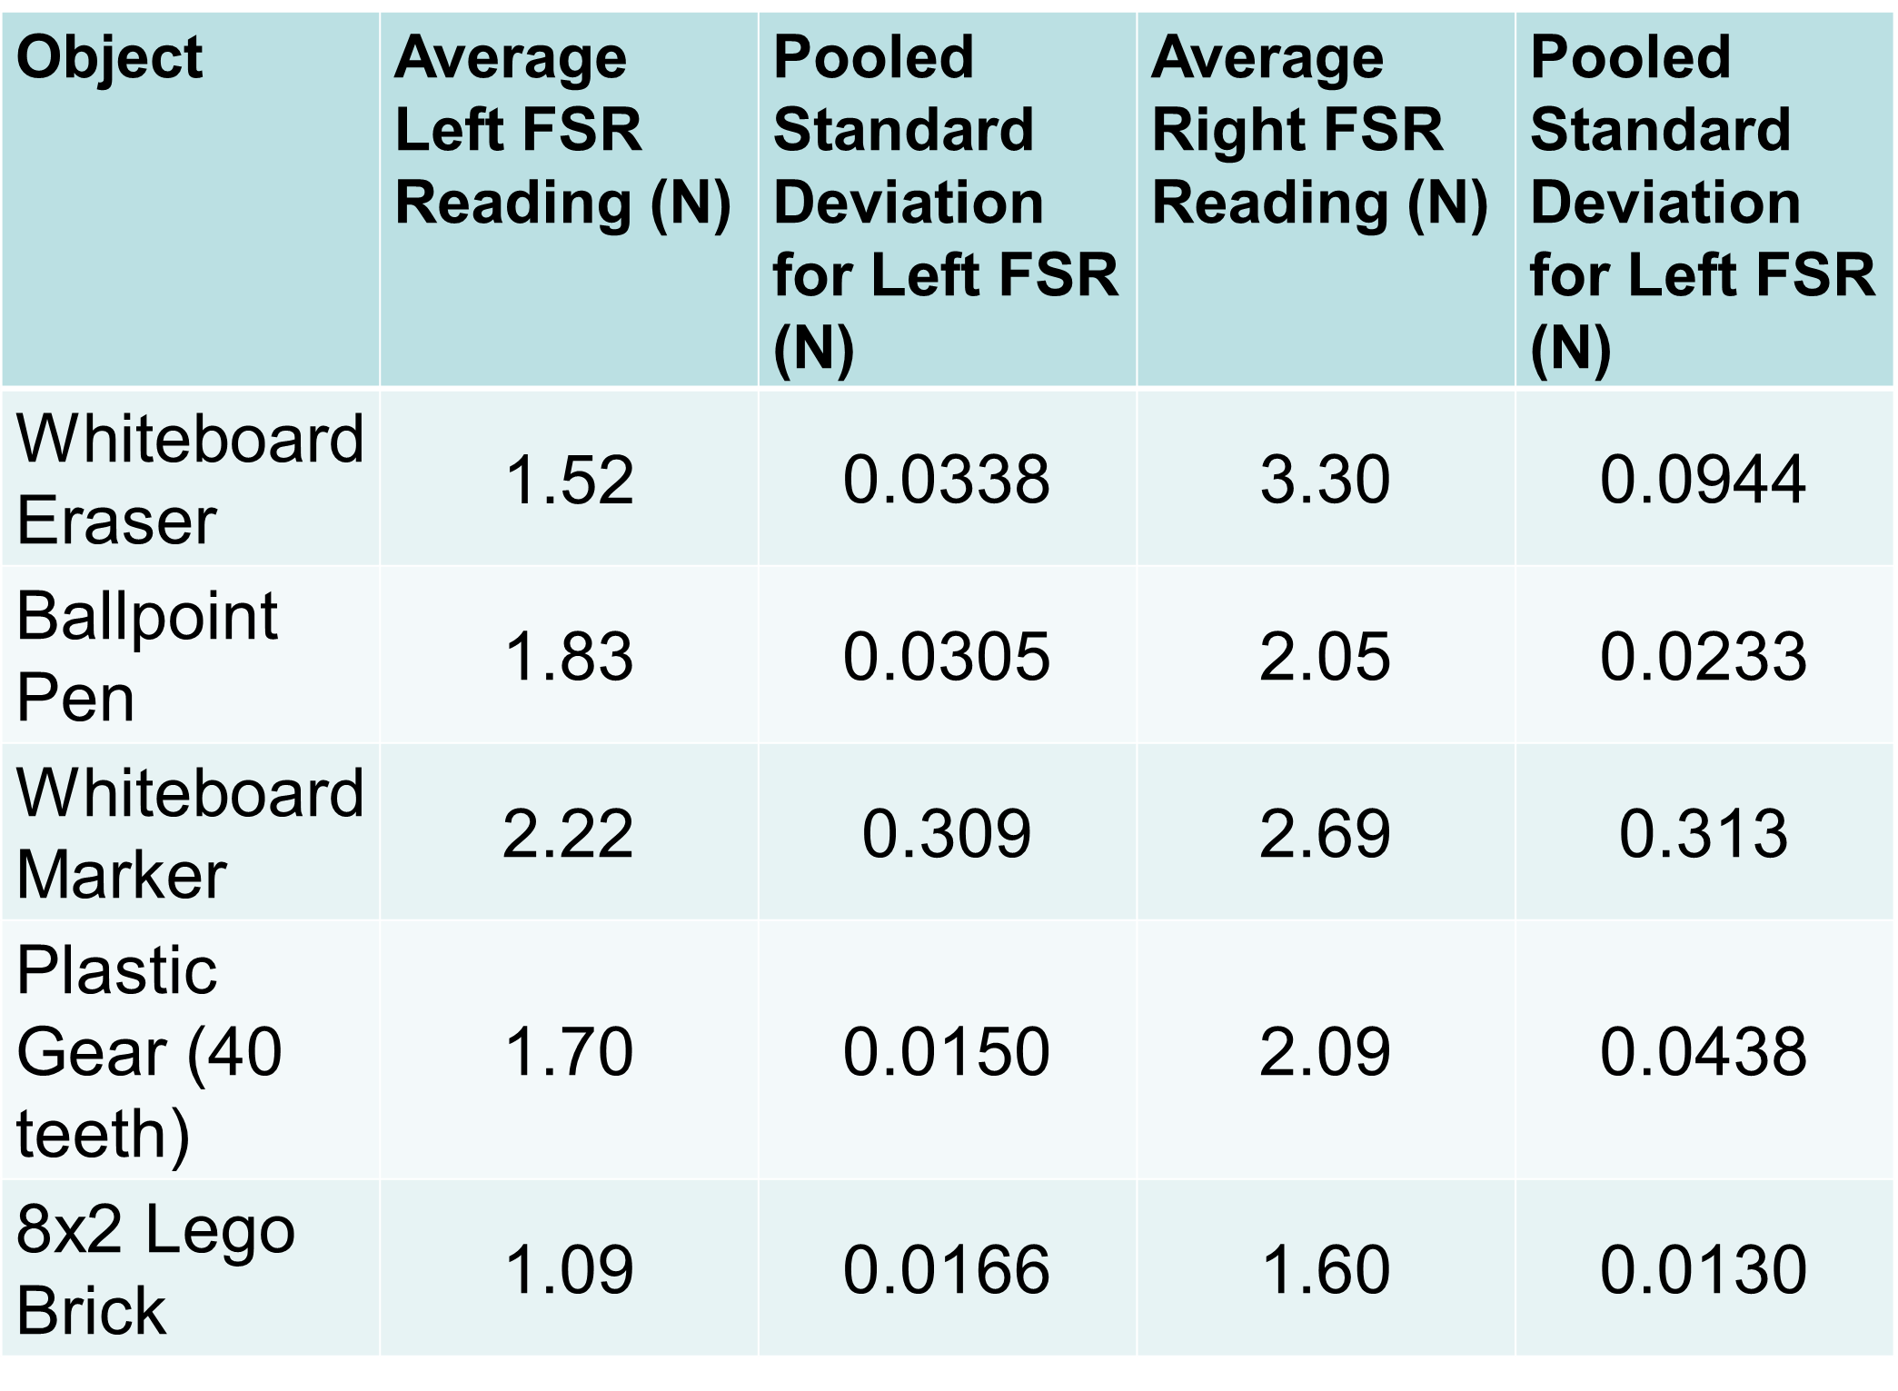
Data from Initial Experiment with FSRs
Grip force applied to a plastic gear
Notes:
-Difficulty keeping everything stable (a lot of movement of components)
-issues with electrical connectors
-gripper would not consistently grip object in the same place
-non-uniform objects produced inconsistencies in force readings
-still no knowledge of how accurate FSRs are

Slide 4
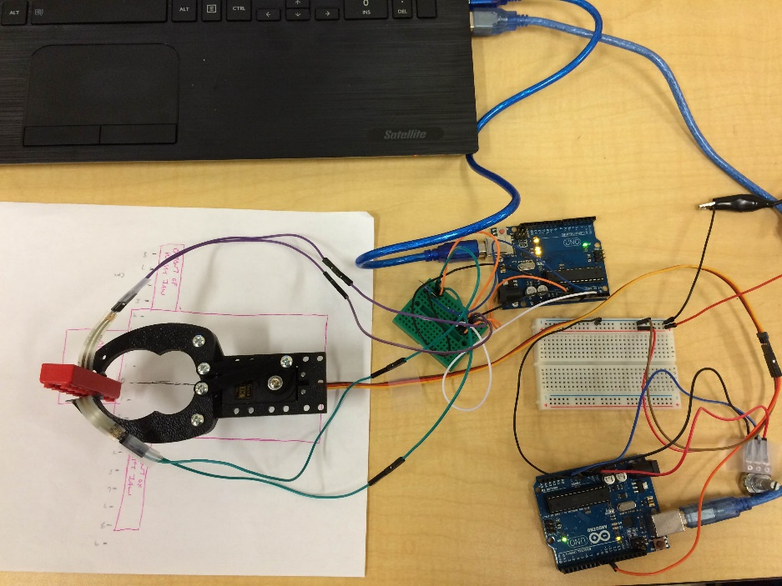
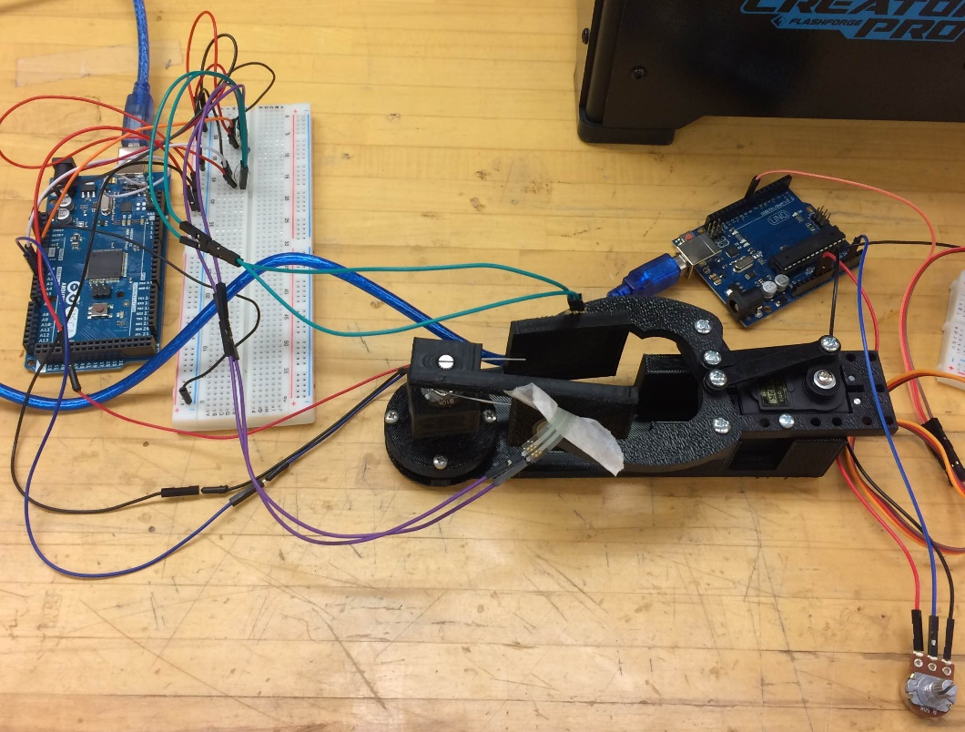
Changes in Setup
Before
After

Slide 5
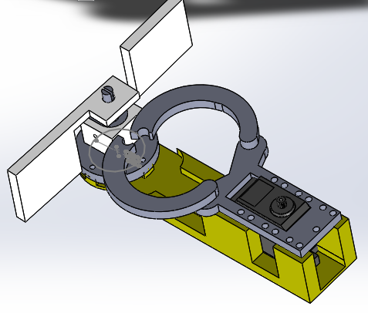
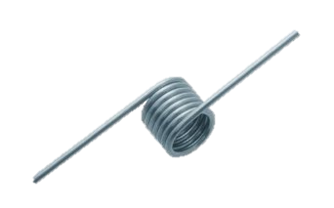
Changes in Experimental Procedures
Stable test bed to mount all components
Able to compare readings from a torsion spring and FSRs simultaneously
Consistently gripped in the same spot
Did 30 trials instead of 10 for different objects
Above: Solidworks assembly of test bed
Left: a 180° torsion spring

Slide 6
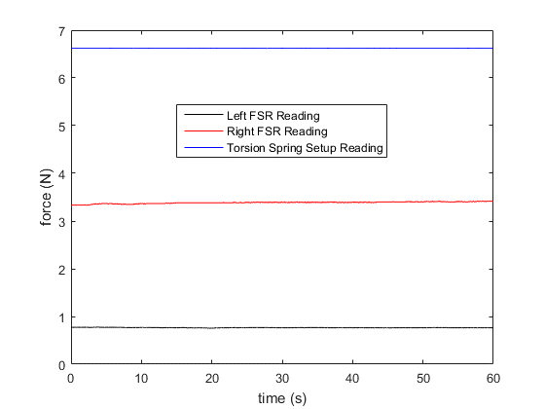
Data from the New Experiment (with torsion spring assembly)
Trial | Average Left FSR Reading | Average Right FSR Reading | Average Torsion Spring Setup Reading
1 | 0.330137 | 1.980386 | 6.930787
2 | 0.766734 | 3.372041 | 6.621172
3 | 4.586414 | 4.69143 | 6.493665
4 | 2.401946 | 3.197892 | 8.334006
5 | 1.959711 | 4.532586 | 7.090165
6 | 2.89983 | 3.64819 | 9.636071
7 | 2.054446 | 1.430803 | 10.03479
8 | 1.75455 | 3.644629 | 10.03479
9 | 2.219138 | 3.862424 | 10.03479
10 | 2.626148 | 3.042145 | 10.03479
11 | 2.026046 | 2.162665 | 10.03479
12 | 2.557159 | 2.281657 | 10.03479
13 | 3.070709 | 1.354307 | 10.03479
14 | 1.866366 | 1.075359 | 10.03479
15 | 3.426502 | 4.778084 | 10.03479
Plot of one of the trials with the test bed

Slide 7

Statistical Analysis
The values from the left and right force sensors were averaged together since the grip force should be the same for both grip ‘fingers’.
2 sample t-test:
  α=.05
  H0: $μ_{1}=μ_{2}$
  H1: $μ_{1}≠μ_{2}$
Results: p<< α; reject null hypothesis and conclude there is a significant difference between the readings from the FSRs and the torsion spring
t-Test: Two-Sample Assuming Equal Variances
 | Variable 1 | Variable 2
Mean (N) | 2.847745633 | 9.328868
Variance (N²) | 0.872749992 | 1.479635
Observations | 30 | 30
Pooled Variance | 1.176192686
Hypothesized Mean Difference | 0
df | 58
t Stat | -23.14496844
P(T<=t) one-tail | 2.78648E-31
t Critical one-tail | 1.671552762
P(T<=t) two-tail | 5.57296E-31
t Critical two-tail | 2.001717484

Slide 8
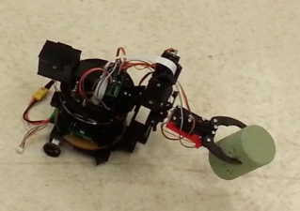
Conclusion and future developments
What I learned:
  FSRs are not very accurate for obtaining force readings
  Programming an Arduino with MATLAB
  How to calculate a spring constant for a torsion spring
  How to better design components for 3-D printing
Future applications
  Will continue to improve the torsion spring test bed
  Can use the FSRs for qualitative measurement on small mobile robot platform, “Pheeno,” while gripping an object
  Can use the torsion spring test bed to test standalone grip strength
Pheeno gripping an object

Slide 9
acknowledgements
Dr. Spring Berman, Department of Mechanical and Aerospace Engineering
Ruben Gameros, Research Specialist, Department of Mechanical and Aerospace Engineering
Sean Wilson, Ph.D. student, Department of Mechanical and Aerospace Engineering

Slide 10
Questions?
Notes:
Put acknowledgements somewhere

